Slide 1
Software Engineering Approach to Human-Computer-Interaction
Chapter 7 Evaluation Techniques

Slide 2
Key Words
Heuristic Evaluation
UAR（Usability Aspect Report）
Think-Aloud

Slide 3
Contents
7.1 Heuristic
7.2 Heuristic Evaluation
7.3 How to Write a Usability Aspect Report (UAR)
7.4 Basic Issues in Think-Aloud Testing
7.5 How to Conduct a Think-Aloud Usability Test
7.6 Think-Aloud Testing vs. Heuristic Evaluation

Slide 4
7.1 Heuristic

Slide 5
What is evaluation?
The role of evaluation
Tests usability and functionality of system
Evaluates both design and implementation
Should be considered at all stages in the design life cycle
Notes:
专家评估，用户参与。

Slide 6
Goals of Evaluation
Assess extent of system functionality
The system’s functionality must accord with the system
Assess effect of interface on user
How easy the system is to learn
Usability
Identify specific problems
Unexpected results/ confusion amongst users

Slide 7
Heuristic Evaluation
Proposed by Nielsen and Molich.
Usability criteria (heuristics) are identified
10 rules
design examined by experts to see if these are violated
Evaluators
Evaluations be done independently
Number:3-5(Nielsen’s experience)

Slide 8
10 Rules
Match the Real World
Consistency and Standards
Help and Documentation
User Control and Freedom
Visibility of system status
Flexibility and Efficiency
Error Prevention
Recognition, Not Recall
Error reporting, Diagnosis, Recovery
Aesthetic and Minimalist Design

Slide 9
1.Match the Real World
Speak user’s language
Use common words, not techie jargon
But use domain-specific terms where appropriate
Don’t put limits on user defined names
Allow aliases/synonyms in command languages
Type mismatch

Slide 10
2.Consistency and Standards
Principle of least surprise
Similar things should look and act similar
Different things should look different
Other properties
Size, location, color, …
Command order
Prefix vs. postfix
delete
erase
remove

Slide 11
Kinds of Consistency

Slide 12
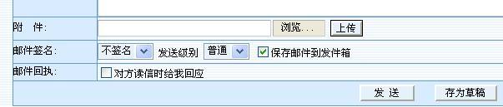



Slide 13

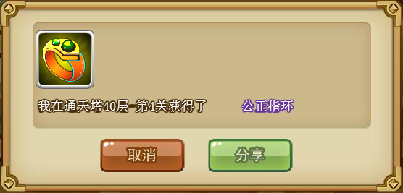

Slide 14
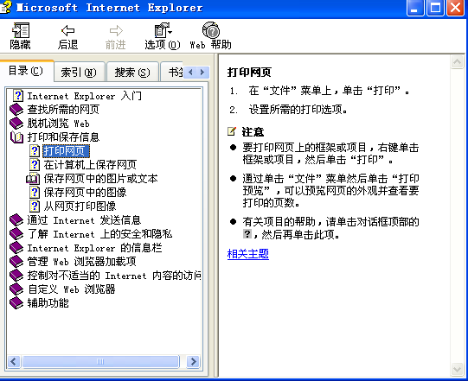
3.Help and Documentation

Slide 15
3.Help and Documentation
Users don’t read manuals
Prefer to spend time working toward their task goals, not learning about your system
But manuals and online help are vital
Usually when user is frustrated or in crisis
Help should be
Always available
Easily Searchable
Relevant to the task

Slide 16
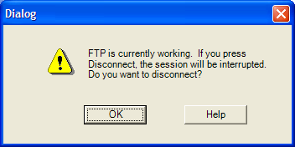
4.User Control and Freedom
Provide undo
Require Confirmation
Let the user be in control

Slide 17
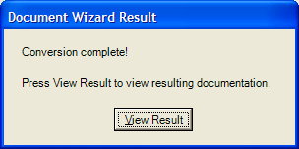
5.Visibility of system status
Keep user informed of system state
Cursor change
Selection highlight
Status bar
Don’t overdo it…
Response time
<0.1 s : seems instantaneous
0.1-1 s: user notices, but no feedback needed
1-5 s: display busy cursor
>5 s: display progress bar

Slide 18
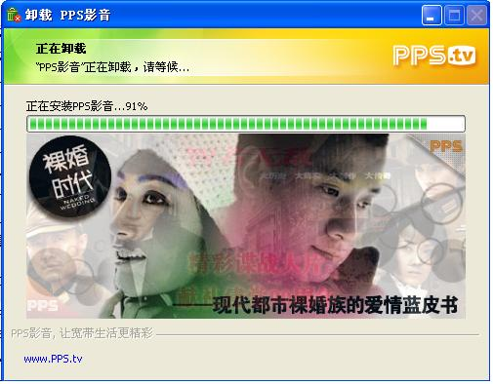

Slide 19
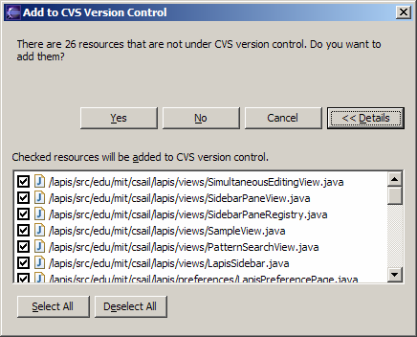
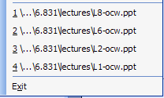
6.Flexibility and Efficiency
Provide easily-learned shortcuts for frequent operations
Keyboard accelerators
Command abbreviations
Bookmarks
History

Slide 20
7.Error Prevention
Even better than good error message is a careful design which prevents a problem from occurring in the first place.
Selection is less error-prone than typing
But don’t go overboard…
Disable illegal commands
If you don’t want this to not be saved, click YES

Slide 21
Description Error
Intended action is replaced by another action with many features in common
Pouring orange juice into your cereal
Putting the wrong lid on a bowl
Avoid actions with very similar descriptions
Long rows of identical switches
Adjacent menu items that look similar

Slide 22
Capture Error
Occurs when there is overlap in the sequence required for the performance of two different actions
Especially when one is done considerably more frequently than the other.
Possible ways of avoiding this class of error
Is to minimize overlapping sequences
Try to catch it where it occurs
Notes:
The person who when to his room to change for dinner and found hhimself in bel
I was using a copying machine, and I was counting the pages. I found myself counting “1,2,3,4,5,6,7,8,9,10,Jack,Queen,King.” (I have been playing cards recently)
I meant to get my car out, but as I passed through the back porch on my way to garage I stopped to put on my Wellington boots and gardening jacket as if to work in the garden.

Slide 23
Mode Error
Modes: states in which actions have different meanings
Caps lock
Avoiding mode errors
Eliminate modes
Visibility of mode
Spring-loaded or temporary modes
Disjoint action sets in different modes

Slide 24
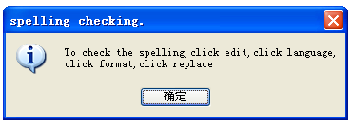
8.Recognition, Not Recall
Use menus, not command languages
Use combo boxes, not textboxes
Use generic commands where possible (Open, Save, Copy Paste)
All needed information should be visible

Slide 25
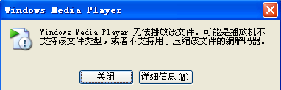
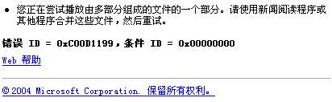
9.Error reporting, Diagnosis, Recovery
Be precise; restate user’s input
Not “Cannot open file”, but “Cannot open file named paper.doc”
Give constructive help
Why error occurred and how to fix it
Be polite and nonblaming
Not “fatal error”, not “illegal”
Hide technical details until requested

Slide 26

10.Aesthetic and Minimalist Design
“Less is More”
Omit extraneous info, graphics, features

Slide 27

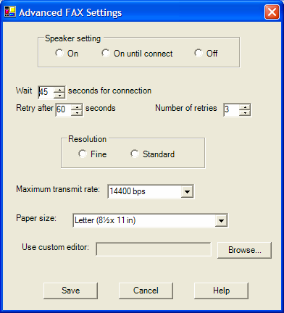
10.Aesthetic and Minimalist Design
Good graphic design
Few, well-chosen color and fonts
Group with white space
Align controls sensibly
Use concise language
Choose labels carefully

Slide 28
Chunking the Heuristics Further
Meet expectations
Match the real world
Consistency & standards
Help & documentation
User is the boss
User control & freedom
Visibility of system status
Flexibility & efficiency

Slide 29
Chunking the Heuristics Further
Handle errors
Error prevention
Recognition, not recall
Error reporting, diagnosis, and recovery
Keep it simple
Aesthetic & minimalist design

Slide 30
Tog’s 16 principles
Anticipation
Autonomy
Color blindness
Consistency
Defaults
Efficiency
Explorabel interfaces
Fitt’s Law
Human interface objects
Latency reduction
Learnability
Metaphors
Protect user’s work
Readability
Track state
Visible navigation

Slide 31
Tog’s 16 principles
Anticipation
Bring to the user all the information and tools needed for each step of the process.
Defaults
Defaults should be easy to "blow away"
Do not use the word "default" in an application or service.
"Standard"
" Use Customary Settings"
"Restore Initial Settings“
…

Slide 33
Tog’s 16 principles
Explorable interfaces
Offer users stable perceptual cues for a sense of "home."
Always allow "Undo."
Learnability
Ideally , products would have no learning curve .
In practice, all applications and services, no matter how simple, will display a learning curve.

Slide 34
Tog’s 16 principles
Protect user’s work
Ensure that users never lose their work as a result of error .
completely unavoidable reason
Readability
high contrast
Favor black text on white or pale yellow backgrounds.
Avoid gray backgrounds.
Pay particular attention to the needs of older people.

Slide 35
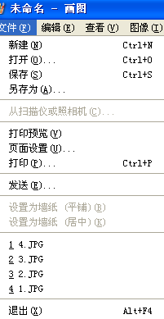
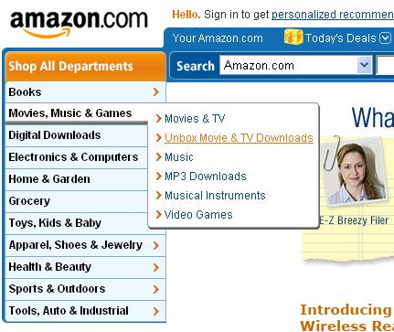
Tog’s 16 principles
Track state
Visible navigation

Slide 36
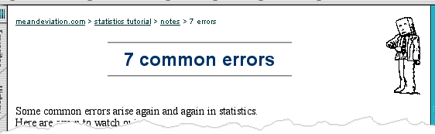
Where You Are – breadcrumbs
shows path through web site hierarchy
top level category
sub-category
web site
this page
live links
to higher
levels
Notes:
Breadcrumbs?

Slide 37
Shneiderman’s 8 Golden Rules
Consistency
Shortcuts
Feedback
Dialog closure
Simple error handling
Reversible actions
Put user in control
Reduce short-term memory load
beginning
Sequences of actions
middle
end

Slide 38
7.2 Heuristic Evaluation

Slide 39
Heuristic Evaluation
Steps
Compare UI against heuristics
List usability problems
Explain & justify each problem with heuristics

Slide 40
How to Do Heuristic Evaluation
Justify every problem with a heuristic
Can’t just say “I don’t like the colors”
List every problem
Even if an interface element has multiple problems
Go through the interface at least twice
The first pass ：get a feel for the flow of the interaction and the general scope of the system.
The second pass ：focus on specific interface elements

Slide 41
How to Do Heuristic Evaluation
Don’t’ limit yourself to the 10 heuristics
we’ve seen others: Fitts’s Law, perceptual fusion, color principles
But the 10 heuristics are easier to compare against

Slide 42
Heuristic Evaluation Is Not User Testing
Evaluator is not the user
users do not know anything about user interface design
HE finds problems that UT often misses
Inconsistent fonts
Fitts’s Law problems
But UT is the gold standard for usability

Slide 43
Hint for Better Heuristic Evaluation
Use multiple evaluators
Different evaluators find different problems
The more the better, but diminishing returns
Nielsen recommends 3-5 evaluators
Each individual evaluator inspect the interface alone
Only after all evaluations have been completed are the evaluators allowed to communicate and have their findings aggregated.
Ensure independent and unbiased evaluations from each evaluator

Slide 44
Hint for Better Heuristic Evaluation
Alternate heuristic evaluation with user testing
Each method finds different problems
Heuristic evaluation is cheaper
The results of the evaluation can be recorded
Written reports from each evaluator
require an additional effort by the evaluators
need to be read and aggregated by an evaluation manager.
Evaluators verbalize their comments to an observer as they go through the interface.
evaluation are available fairly soon after the last evaluation session

Slide 45
Hint for Better Heuristic Evaluation
It's OK for observer to help evaluator
the evaluators have limited domain expertise /need to have certain aspects of the interface explained.
This wouldn’t be OK in a user testing
For traditional user testing, one normally wants to discover the mistakes users make when using the interface
Discover the answers to their questions by using the system

Slide 46
Formal Evaluation Process
Training
Meeting for design team & evaluators
Introduce application
Explain user population, domain, scenarios
Evaluation
Evaluators work separately
Generate written report, or oral comments recorded by an observer
Focus on generating problems, not on ranking their severity yet
1-2 hours per evaluator

Slide 47
Formal Evaluation Process
Severity Rating
Evaluators prioritize all problems found (not just their own)
Take the mean of the evaluator’s ratings
Debriefing
Evaluators & design team discuss results, brainstorm solutions

Slide 48
Severity Ratings
Contributing factors
Frequency: how common?
Impact: how hard to overcome?
Persistence: how often to overcome?
Severity scale
Cosmetic: need not be fixed
Minor: needs fixing but low priority
Major: needs fixing and high priority
Catastrophic: imperative to fix

Slide 49
Evaluating Prototypes
Heuristic evaluation works on:
Sketches
Paper prototypes
Unstable prototypes
“Missing-element” problems are harder to find on sketches
Because you’re not actually using the interface, you aren’t blocked by feature’s absence
Look harder for them

Slide 50
7.3 How to Write a Usability Aspect Report (UAR)

Slide 51
The Elements of a UAR
UAR Identifier — <Problem or Good Feature>
Succinct description of the usability aspect
Evidence for the aspect
Explanation of the aspect
Severity of the problem or benefit of the good feature
Possible solution
Relationship to other usability aspects (if any)

Slide 52
User Interface Hall of Shame

Slide 53
UAR Identifier
This should be a unique identifier for the purposes of filing.
If more than one person is working on the project or more than one analysis technique is being used, this identifier could contain letters and numbers.
Follow the unique identifier with the word "Problem," if the report pertains to a usability problem of the interface, or the words "Good Feature," if it describes an aspect of the interface you feel should be preserved in any redesign.

Slide 54
Succinct Description of the Usability Aspect
This description will be used as the "name" of this UAR when you talk about its relation to other UARs.
Make the name as short as possible (about three to five words) but still descriptive and distinguishable from other aspects of the system.
If this UAR is about a problem (as opposed to a good feature), make sure you have a name that describes the problem, rather than a solution.

Slide 55
Evidence for the Aspect
This is the objective supporting material that justifies your identifying the aspect as worthy of report.
This section needs to contain enough information for a reader of this UAR to understand what triggered the report.

Slide 56
Explanation of the Aspect
This is your interpretation of the evidence.
You need to provide enough context in this explanation for the reader to understand the problem—even if they do not know the system or domain as well as you do.

Slide 57
Severity of the Problem or Benefit of the Good Feature
This is your reasoning about how important it is to either fix this problem or preserve this good feature.
This includes how frequently the users will experience this aspect, whether they are likely to learn how it works, whether it will affect new users, casual users, experienced users, etc.

Slide 58
Possible Solutions and Potential Trade-offs
If this aspect is a problem , this is the place to propose a solution.
It is not necessary to have a solution as soon as you identify a problem.

Slide 59
Relationship to Other Usability Aspects
This is where you record which UARs this one is related to and a statement about how it is related.
Make sure that all the related UARs point to each other.

Slide 60
7.4 Basic Issues in Think-Aloud Testing

Slide 61
What is Think-Aloud Usability Testing?
It is a technique for assessing the usability of a prototype of an interface.
The essence of the technique is for you to ask a user to think-aloud while performing a task on your system; you watch silently and learn how the user thinks about the task and where the user has problems using your system.

Slide 62
Think-Aloud Protocol Analysis
Cognitive psychology researchers are interested in
how people solve problems
the details of what information people pay attention to
how they represent that information
how they bring prior knowledge to bear
what transformations they make to information in the course of solving some puzzle or performing some task

Slide 63
Think-Aloud Protocol Analysis
Newell, Shaw, and Simon, 1958
Two parts of this method
Collect think-aloud data (protocols)
Extremely useful in understanding the usablility of computer systems
Analyze the data by building a model of it
Not useful in most UI design

Slide 64
Think-Aloud Protocol Analysis
Three types of verbalizations of thoughts
Type 1: Talk-aloud
Type 2: Think-aloud
Type 3: Mediated processes
Referring back to WM
stores all the results of perception once those things have been understood by the person.

Slide 65
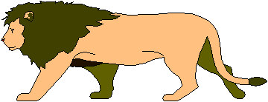
Think-Aloud Protocol Analysis

Slide 66
Think-Aloud Protocol Analysis
WM
all the intermediate states in a problem solution, information that is figured out along the way to the solution.
theory behind Think-aloud protocols
WM holds a lot of clues as to what a person was thinking about as they solved the problem or performed a task.
people can verbalize the linguistic contents of their WM.

Slide 67
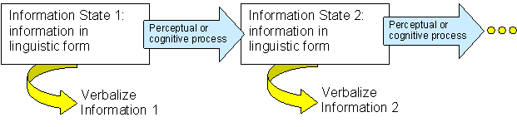
Type 1:Talk-Aloud
“talk aloud”: Trying to get just these pieces of information to come “out of their mouth” right after they enter WM

Slide 68
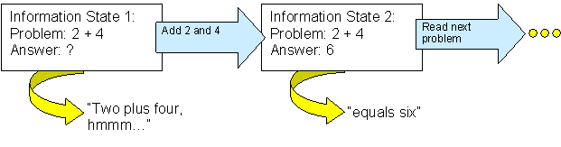
Type 1:Talk-Aloud
Example :
A person is given a simple addition problem: 2+4 = ?

Slide 69
Type 1:Talk-Aloud
Asking a person to “talk aloud” as they work on a task does not change their thinking strategies or slow them down in their thinking.
Much of the information people use to solve problems with modern GUI computers systems is not linguistic in nature.

Slide 70
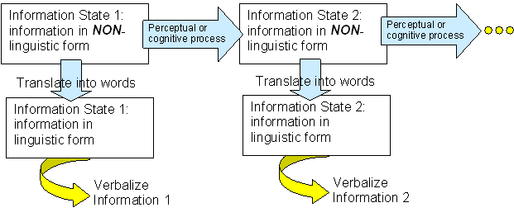
Type2: Think-Aloud

Slide 71
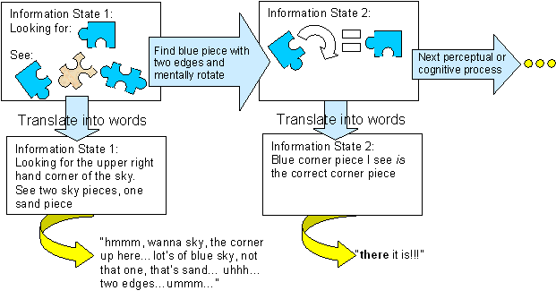
Type2: Think-Aloud
Example:
Being asked to do a jigsaw puzzle picturing a beach, which is primarily blue sky and brown sand.

Slide 72
Type2: Think-Aloud
“Think aloud” does not change the way people think about problems.
But it does slow them down.
This is the type of protocol most often used in usability research.

Slide 73
Type 3: Mediated Processes
When you ask someone to verbalize, but make some sort of demand on them to add more processing to the information.
explain their thoughts.
report only one type of information
Not recommended for UI design because psychologists have shown that this does change the way people think as they solve problems.

Slide 74
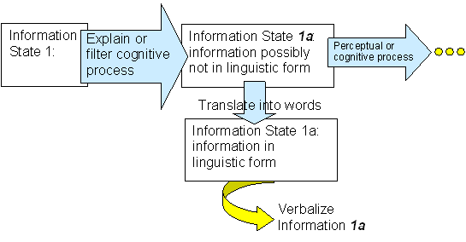
Type 3: Mediated Processes

Slide 75
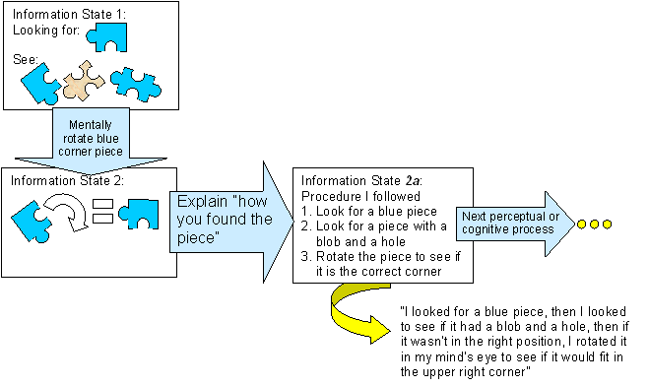
Type 3: Mediated Processes

Slide 76
Critical Incident Analysis
World War II
collecting the data
analyzing it
The Psychological Bulletin (Flanagan, 1954, volume 51, number 4, pp. 327–58).
original critical incident technique
observers report critical incidents
observations are gathered through interviews or questionnaires
The observations gathered categorized and interpreted by analysts and put into a final report.

Slide 77
Critical Incident Analysis
The general procedure for the critical incident technique
1. Someone performs a task in the real world.
2. An observer reports critical incidents after the fact in interviews or questionnaires administered by an analyst.
3. The analyst categorizes and interprets the observations.
4. The analyst writes a summarizing report of the data and interpretations.

Slide 78
Critical Incident Analysis
Usability studies in UI design procedure
1. A user thinks aloud as he or she performs a task using a prototype of the computer system being evaluated, usually in a laboratory setting, usually videotaped or using screen-and-voice capture software.
2. An analyst looks at the recording of the think-aloud protocol session and reports critical incidents using the UAR format.
3. The analyst categorizes and interprets the observations.
4. The analyst writes a summarizing report of the data and interpretations.

Slide 79
Critical Incident Analysis
Evidence slot of a UAR
Definition of critical incident
By incident is meant any observable human activity that is sufficiently complete in itself to permit inferences and predictions to be made about the person performing the act.
To be critical, an incident must occur in a situation where the purpose or intent of the act seems fairly clear to the observer and where its consequences are sufficiently definite to leave little doubt concerning its effects.
Such incidents are defined as extreme behavior, either outstandingly effective or ineffective with respect to attaining the general aims of the activity.
Explanation slots of a UAR
Determine which behavior is worth writing up into a UAR

Slide 80
Ethics for Empirical Studies
Four important ethical concepts
Testing the interface, not the participant
The user is not like me
participants ：like your eventual actual users
Not always pay attention
not never make mistakes
Not never be in bad moods
No matter what the participants do, always ask yourself what about your system nudged them in that direction, rather than blaming the participant for not knowing enough or not paying attention or not reading.

Slide 81
Ethics for Empirical Studies
Voluntary participation
Not put any pressure on people to continue in a study once they have started.
allows participants to stop at any time.
be sensitive to the many ways people express a desire to stop a session.
Not "I want to stop now."
"I'm so stupid I'll never be able to finish this," …
"Would you like to stop now?"

Slide 82
Ethics for Empirical Studies
Maintain anonymity
Always use the participant numbers when discussing or writing about the data, never the participants' names.
You must have the participants' name because you may need the consent form at some point in the future
name | number
Jane Doe | P1
John Smith | P2

Slide 83
Ethics for Empirical Studies
Informed consent
what the experiment is about
what procedures will be used
what compensation they will receive
they are free to stop and leave at any time

Slide 84
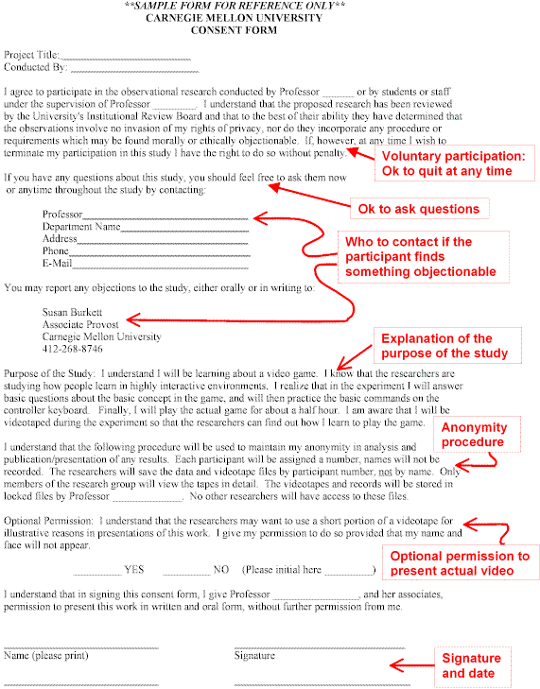

Slide 86
7.5 How to Conduct a Think-Aloud Usability Test

Slide 87
Think-Aloud usability test procedure
1.Define the study’s framework
2.Choose what to observe
3.Prepare for the think-aloud usability test
4.Introduce the participants to the observation procedure
5.Conduct the observation
6.Analyze the observation
7.Find possible redesigns
8.Write a report

Slide 88
1.Defining the Study’s Framework
The development team should ask itself the questions
What problem is this system trying to solve, or what work is it trying to support?
What level of support will the users have—in terms of training to use this system, documentation, online help, or other resources?

Slide 89
1.Defining the Study’s Framework
The development team should ask itself the questions
What types of usage do we hope to evaluate in the usability tests? Walk-up-and-use, first-time use? Users skilled in the task domain using this particular system for the first time? Exploratory use with no time pressure or goal-directed use under time pressure? Or, other aspects?

Slide 90
1.Defining the Study’s Framework
The development team should ask itself the questions
What usability goals do we have for this system? That 90% of users can accomplish a simple task within 3 minutes with no training? That half of the people trained in using this system will perform with less than one recoverable error per task?

Slide 91
2.Choosing What to Observe
The choice of task is influenced by several things
The content of the tasks
The need for training to do the tasks
The duration of the tasks
The integration of the tasks
Notes:
。

Slide 92
The content of the tasks
a similar system
include the most frequent tasks
include tasks that cover the range of functionality of the system
create things from scratch
delete or modify existing things
error-recovery tasks
very important, though possibly infrequent, tasks

Slide 93
The need for training to do the tasks
The set becomes "Learn to do Task A" and "Task A," instead of just "Task A."
test training materials as well as the system
paper-based reference materials
Web pages
lectures
online tutorials

Slide 94
The Duration of the Tasks
Duration
No more than an hour at a time
No more than two hours on a single day
includes the training to do the task
review the training on the second day
Notes:
任务持续时间。、
一般来说不能让参与者坐在一个地方完成任务的时间超过1个小时，每天不能超过2小时，否则参与者会疲劳，不能很好的完成任务。那么你在设计测试套的时候就需要注意，每个1个小时就应该让参与者休息一会，如果说一天已经进行了2个小时，按摩就应该停止测试。这个持续时间包括了培训的时间。如果用2个小时来进行培训就需要在第二天进行测试。在测试前再简单的复习一下培训内容。

Slide 95
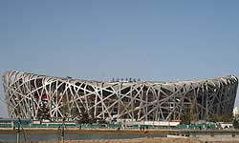
The Integration of Small Tasks
tasks in the test suite that are long enough
test the integration of your system with other systems they might use

Slide 96
3.Preparing for the Observation
Preparations before running any actual think-aloud sessions
Setting up a realistic situation for data collection
Writing up the task scenarios
Practicing the session
Recruiting users

Slide 97
Setting up a realistic situation for data collection
This situation will differ depending on the system you are testing.
desktop system for a PC ---an office-like set-up
PDA ---almost anywhere
Navigation devices to be placed in cars ---driving or in driving simulators

Slide 98
Writing up the task scenarios
on a separate sheet of paper
one task at a time
purely verbal
include pictures or diagrams
links the tasks in the series into a meaningful narrative

Slide 99
Practicing the session
Do not underestimate the difficulty
hardware and software
instructions must be clear
data-capture equipment must work
preparatory phase of the testing
Practice first with yourself
Practice next with a friend
Practice finally with someone who has a similar background to the users you will be using in your study

Slide 100
Recruiting users
the same background knowledge as your eventual users will have
may need to compensate users for their participation
need at least three or four participants
iterative testing

Slide 101
4.Introducing Participants to the Procedure
Describe the purpose of the study in general terms
Train the user to “Think Aloud”
Explain the rules of the observation

Slide 102
Describe the Purpose of the Study in General Terms
Give a brief introduction to the entire study with the following elements.
Introduce yourself (name and title)
Introduce your organization and its purpose
State the goal of the particular study
State that you are testing the computer system; you are not testing the user

Slide 103
Describe the Purpose of the Study in General Terms
Give a brief introduction to the entire study with the following elements.
Tell them that their participation is purely voluntary and that it is OK if they want to stop at any time.
Give the participant the consent form, give them time to read it quietly, and ask for their signature.
Show the participant the equipment in the room, explain what each piece does, and demonstrate the ones they will have to use.（novel devices ）
Show the participant how you are going to record their voice and actions.

Slide 104
Train the User to “Think Aloud”
The following instructions elicit good think-aloud behavior with users.
What you are interested in? what you want the user to do?
what you think about as you perform the tasks
tell me everything you are thinking
I would like you to talk aloud constantly
I don't want you to try to plan out what you say or try to explain to me what you are saying.
If you are silent for any long period of time, I will ask you to talk.

Slide 105
Train the User to “Think Aloud”
The following instructions elicit good think-aloud behavior with users.
Begin with some practice problems which solved all in our heads.
Developer demonstrate first
How many windows are there in my mother's house?
Then the user turn
Please think aloud as you name 20 types of animals.
Begin with some practice problems

Slide 106
Explain the Rules of the Observation
You will not be able to answer questions during the observation.
They should ask their questions anyway. You'll record them and answer them at the end of the observation.
If they fall silent for any length of time, you will ask them to keep talking.

Slide 107
5.Conducting the Observation
Introduce the observation phase
Begin the observation
Conclude the observation

Slide 108
Introduce the Observation Phase
First, describe the system you are going to test.
Tell the participant as much about the system as you expect real users will know
Then tell the participant about the tasks you wish him or her to do.
more than one task
written on a sheet of paper
diagrams or pictures
At this point, ask the participant if she or he has any questions about the goals of the study, the procedures, the product, or the task.
don't answer questions like "How do I do that task?"

Slide 109
Begin the Observation
Check that your recording devices are still working, and let the user work on the tasks while thinking aloud .
As the user performs the task, actively monitor their progress.
If the user slips into explaining their procedures, then stop him or her and say,
"Please don't try to explain to me what you are doing. Just act as if you are alone, speaking to yourself as you solve the problem."
Be sensitive to a severe desire to quit on the user's part.

Slide 110
Conclude the Observation
Why we need ask the user if he or she has any opinions about the product they just tested and if they have any suggestions about what the company could do to improve the product?
It gives them a chance to express their opinion, which people often want to do.
Users some times have great ideas that you can only collect by asking.

Slide 111
6.Analyzing the Observation
Establish criteria for critical incidents
View the recorded behavior and write UARS

Slide 112
Establish Criteria for Critical Incidents
“What is a problem for this system?”,Not “What are the problems?”
Different design situations will generate different criteria for criticality.
walk-up-and-use kiosk at the Olympics :limit-of-three criteria
data-analysis tool
Some criteria that are useful for systems and are easily prototyped.
no more than about 10 criteria

Slide 113
Possible Criteria for Problems | Possible Criteria for Good Features
The user articulates a goal and cannot succeed in attaining that goal within three minutes | The user describes something as a positive effect or says that something is really easy.
The user articulates a goal, tries several things, and then explicitly gives up. | The user expresses happy surprise.
The user articulates a goal and has to try more than three things to find the solution. | Some previous analysis (e.g., a Heuristic Evaluation) has predicted a usability problem, but this user has no difficulty with that aspect of the system.
The user does not succeed in a task. That is, there is a difference between what you asked the user to do in the task and what they actually did.
The user expresses distressed surprise.
The user describes something as a negative effect or says that something is a problem.
The user makes a design suggestion.

Slide 114
View the Recorded Behavior and Write UARs
Evidence for the aspect
Explanation of the aspect
Severity of the problem or benefit of the good feature
Possible solution, including possible trade-offs

Slide 115
Evidence for the aspect
Evidence for a critical incident in a think-aloud usability test includes the actual behavior of the participant.
what the user said
what the user did
what the user could have seen
replay this incident anytime
both the purpose of the user's actions—and the consequences of those actions—should be fairly clear.
Facts， only the facts

Slide 116
Evidence for the aspect
your evidence will start with the user's statement of a goal
much easier to understand how the interface supported or failed to support
"I wanna find…"
"Now, let's try to…"

Slide 117
Evidence for the aspect
Sometimes the user will not explicitly voice the goal
the act of reading the task description would be evidence
Sometimes the system sets the user's goal
the appearance of a dialog box and the fact that it is moded should be recorded as evidence

Slide 118
Explanation of the aspect
your hypothesis about what the user was seeing, interpreting, understanding, or guessing as he or she was performing the acts you record in the evidence
the observed behavior in the evidence slot
the user's background knowledge
how the system actually works
Sometimes there will be more than one plausible explanation for the evidence.

Slide 119
Severity of the problem or benefit of the good feature
severity can be related to the criteria used to identify the incident as critical.
the user explicitly giving up on a task is probably more severe than the user expressing distressed surprise and moving on
varies with the design situation

Slide 120
Possible solution, including possible trade-offs
In general, a solution to a usability problem comes from supporting the user's goals more directly.
Ask yourself
if the goal is supported by the system
if not, why not?
what it was about the system that guided the user to form an unreasonable goal.
Sometimes users will generate solutions themselves

Slide 121
7.Finding possible Redesigns
Relate different usability aspects
Determine possible solutions

Slide 122
Relate different usability aspects
look for users' similar goals
The same action on different objects
a string of different actions on the same object
This integration with other applications

Slide 123
Determine possible solutions
As with the solutions for individual UARs, the solution to most usability problems comes from supporting the user's goals more directly.
generate other possible integration requirements.
check your ideas with a quick Heuristic Evaluation

Slide 124
8.Writing a Summarizing Report
Three levels of severity
This usability aspect MUST be fixed before the product is shipped, or the product will be unusable for the customers.
This usability problem SHOULD be fixed—even if it means expending some resources to do so.
It is DESIRABLE that this usability problem be fixed before the product is released—but only if the effort to do so is trivial (that is, if the fix costs practically nothing).

Slide 125
7.6 Think-Aloud Testing vs. Heuristic Evaluation

Slide 126
Think-Aloud Testing vs. Heuristic Evaluation
Many usability aspects identified in HE are confirmed in Think-Aloud usability tests.
these techniques do not overlap completely and are best used in concert with each other.

Slide 127
"False Alarms" vs. True Problems
Two rules of thumb to apply to usability problems that have been identified in heuristic evaluation but not confirmed as such in think-aloud tests.
review the observations of the think-aloud data specifically to see if the situation that the HE UAR refers to did indeed arise during the test.

Slide 128
"False Alarms" vs. True Problems
Two rules of thumb to apply to usability problems that have been identified in heuristic evaluation but not confirmed as such in think-aloud tests.
In particular, if the system you are designing is one that real users will use regularly (such as a word processor or spreadsheet), problems predicted by the Flexibility and Efficiency of Use heuristic should be acted upon—even if they do not show up in the think-aloud tests. That heuristic predicts usability for skilled users, not new users, and think-aloud tests typically will not provide data for that type of user.

Slide 129
Think-Aloud Usability Tests Can Show Things HEs Can't Show
When an HE is done using a paper prototype (i.e., just sketches of a design), it cannot identify problems with the dynamics of the system.
In practice, HEs are typically done without framing the analysis in terms of a real-world task, whereas think-aloud tests typically try to simulate real task situations as closely as possible.
It is a certainty that users do things would never be predicted by any analytic technique available.

